Slide 1


Security for IOT communications
Presented By:
Apoorva Saxena

Slide 2

Objective of this project
Understanding the functioning of IOT and how secure communication works.
Challenges and overhead created due to need of encrypted communication.
Weaknesses in an IOT based system and how they can be exploited.

Slide 3

What I am trying to do?
Devise a format of secure communication over the network.
Implement the communication format over a MQTT broker system.
Emulate an IIOT(Industrial Internet Over Things) scenario to test the viability of the communication format.
(Work in progress) Deploy the system over Amazon EC2 AWS services for real world testing.

Slide 4

Why secure IOT communication?
As a student of Information Assurance and Distributed Systems, I realized how important secure communication is for the functioning of a modular system.
The concept of IOT is based on a distributed system communicating via network such that the worker unit and the controller unit can be geographically apart.

Slide 5

Technologies Used
RSA Encryption
AES Encryption using PyCrypto API
MQTT messaging protocol for IOT communication
HiveMQ : Cloud based MQTT broker

Slide 6

IOT

Slide 7
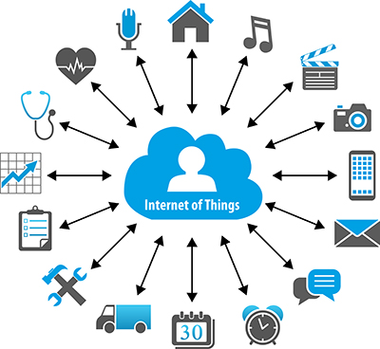
What is IOT?
The Internet of Things (IoT) is a system of interrelated computing devices, mechanical and digital machines, objects, animals or people that are provided with unique identifiers and the ability to transfer data over a network without requiring human-to-human or human-to-computer interaction
Each thing is uniquely identifiable through its embedded computing system but is able to inter-operate within the existing Internet infrastructure.
The IoT allows objects to be sensed or controlled remotely across existing network infrastructure, creating opportunities for more direct integration of the physical world into computer-based systems, and resulting in improved efficiency, accuracy and economic benefit in addition to reduced human intervention.

Slide 8
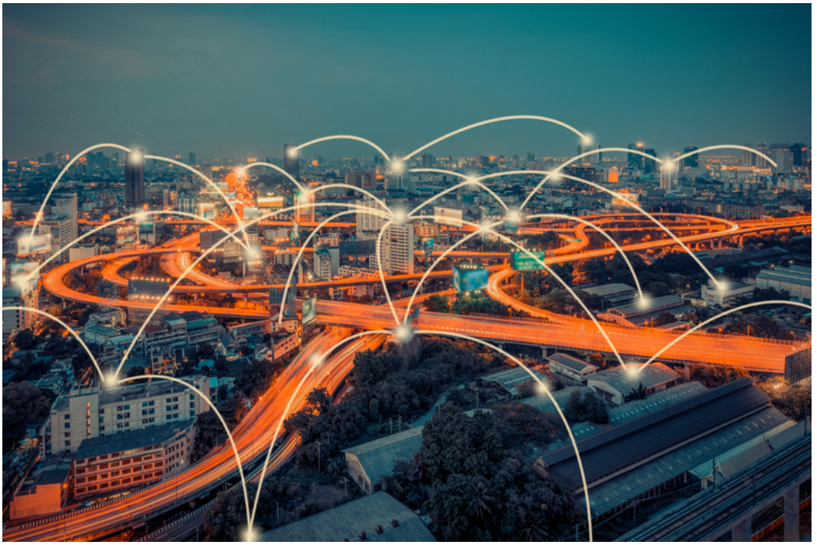
IOT continued..
How it began?
Adding RFID tags to expensive pieces of equipment to help track their location was one of the first IoT applications. But since then, the cost of adding sensors and an internet connection to objects has continued to fall, and experts predict that this basic functionality could one day cost as little as 10 cents, making it possible to connect nearly everything to the internet.
How big is it?
Total spending on IoT endpoints and services will reach almost $2tn in 2019, with two-thirds of those devices found in China, North America and Western Europe. Out of that 8.4 billion devices, more than half will be consumer products like smart TVs and smart speakers. The most-used enterprise IoT devices will be smart electric meters and commercial security cameras

Slide 9
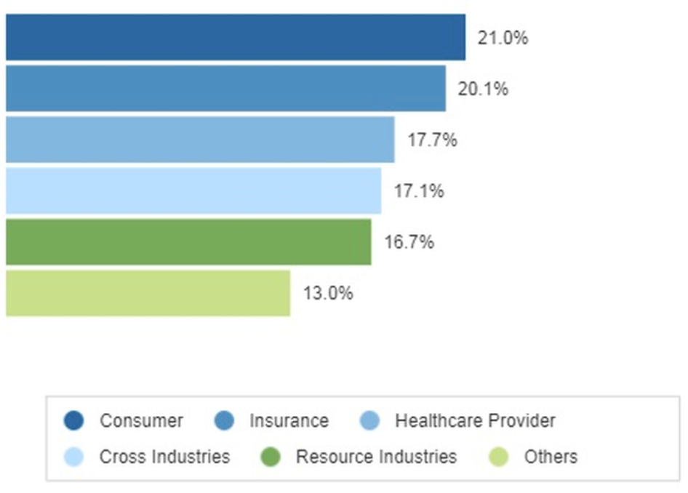
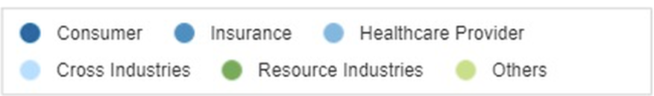
IOT in Industries
(IIOT)
What is Industrial IOT?
The key of Industrial IOT(IIOT) is that enterprises should have access to more data about their own products and their own internal systems, and a greater ability to make changes as a result.
Manufacturers are adding sensors to the components of their products so that they can transmit back data about how they are performing. This can help companies spot when a component is likely to fail and to swap it out before it causes damage.
Companies can also use the data generated by these sensors to make their systems and their supply chains more efficient, because they will have much more accurate data about what's really going on.

Slide 10
Funny (yet useful) examples of IOT!!
In India recently an air conditioner manufacturing company has declared that soon it’s gonna provide a facility to switch your air conditioner ON/OFF with a simple SMS. The point is to get to a cool room when you get back from India’s tropical heat.
Trying to get Google Home control your sprinkler ON/OFF even when you are not at home by setting reminders.

Slide 11
MQTT

Slide 12
How MQTT works?
It is a nice lightweight publish and subscribe system where you can publish and receive messages as a client.
It is a simple messaging protocol, designed for constrained devices and with low-bandwidth. So, it’s the perfect solution for Internet of Things applications.
Main MQTT concepts:
Publish/Subscribe
Topics
Broker

Slide 13
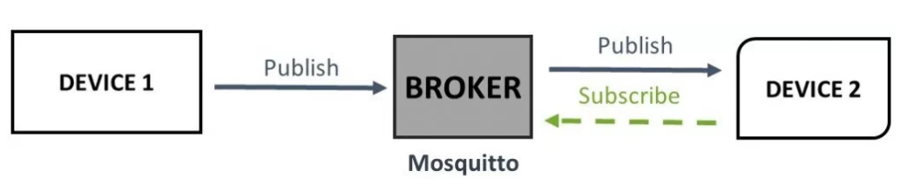
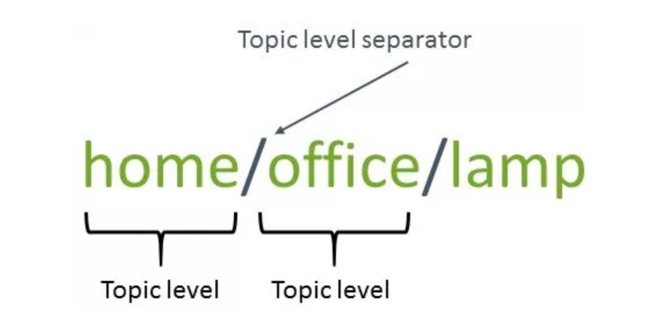
How MQTT works?
Publish/Subscribe
Broker
The broker is primarily responsible for receiving all messages, filtering the messages, decide who is interested in it and then publishing the message to all subscribed clients.
Topics
Topics are the way you register interest for incoming
messages or how you specify where you want to
publish your message

Slide 14
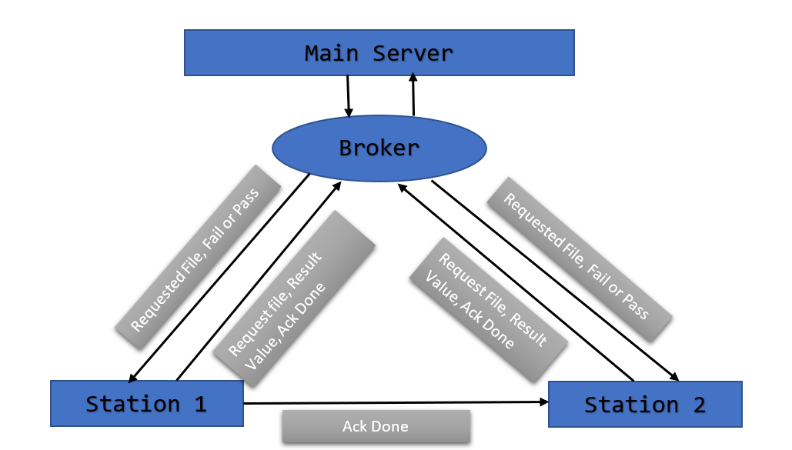
How MQTT works?

Slide 15
Why MQTT?
It provides an always on connection. Thus, anytime a server updates a file in a certain topic the subscribed station automatically subscribes to the updated file.
There is no direct connection between the main server and the individual stations
If the main server were to go offline for some reason the broker would be able to provide the files to the subscribers if they are subscribed to the topic
MQTT offers three Quality of Service(QOS) at most once, at least once and exactly once

Slide 16
IOT Emulation

Slide 17
Communication Format Explained
All the communications are AES encrypted.
RSA encrypted AES private key is sent before communication begins.
Credentials of both the nodes are confirmed by the respective receiver node.
Topics of messages are checked as well. In case an unknown topic is received ‘Input not recognized’ error is thrown.
Different RSA public and private key pairs between different pairs of adjacent nodes. In case an attacker is able to take control over a node, entire communication channel is not compromised.

Slide 18
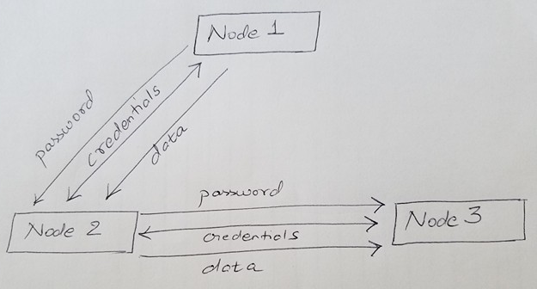
How the IOT Emulation works?
The idea was to try and simulate a distributed nodal like structure.
The sender and receiver nodes exchange credentials to authenticate the identities.
Once identity is established the sender node sends the data to the receiver node.
If credentials are not confirmed ‘Unauthorized User’ error is thrown.
If message topic is not recognized, ‘Input not recognized’ error is thrown.
The functioning of a node depends on the input from the previous node.

Slide 19
Demo

Slide 20
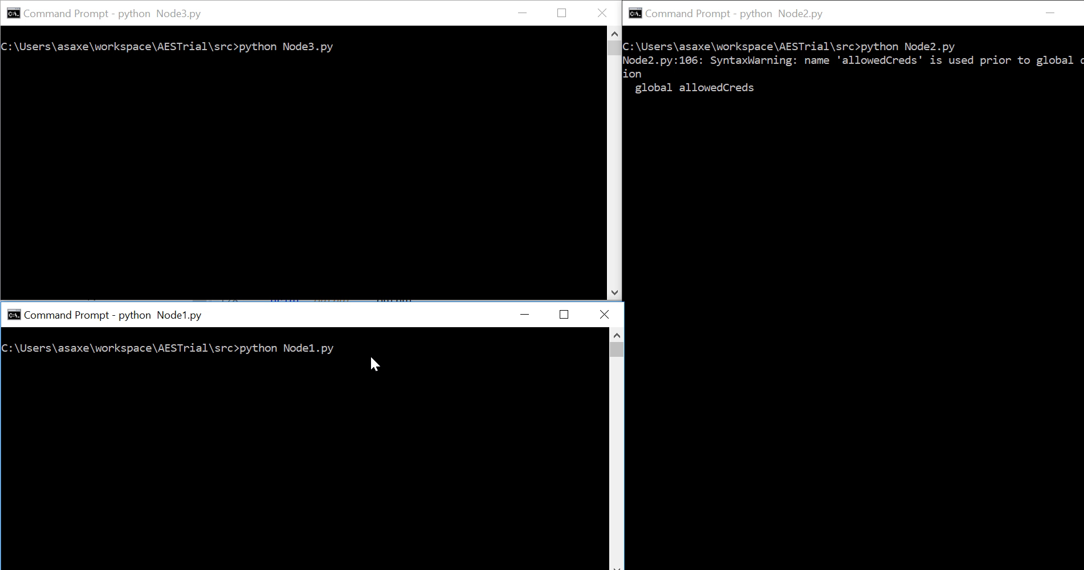
Normal functioning

Slide 21
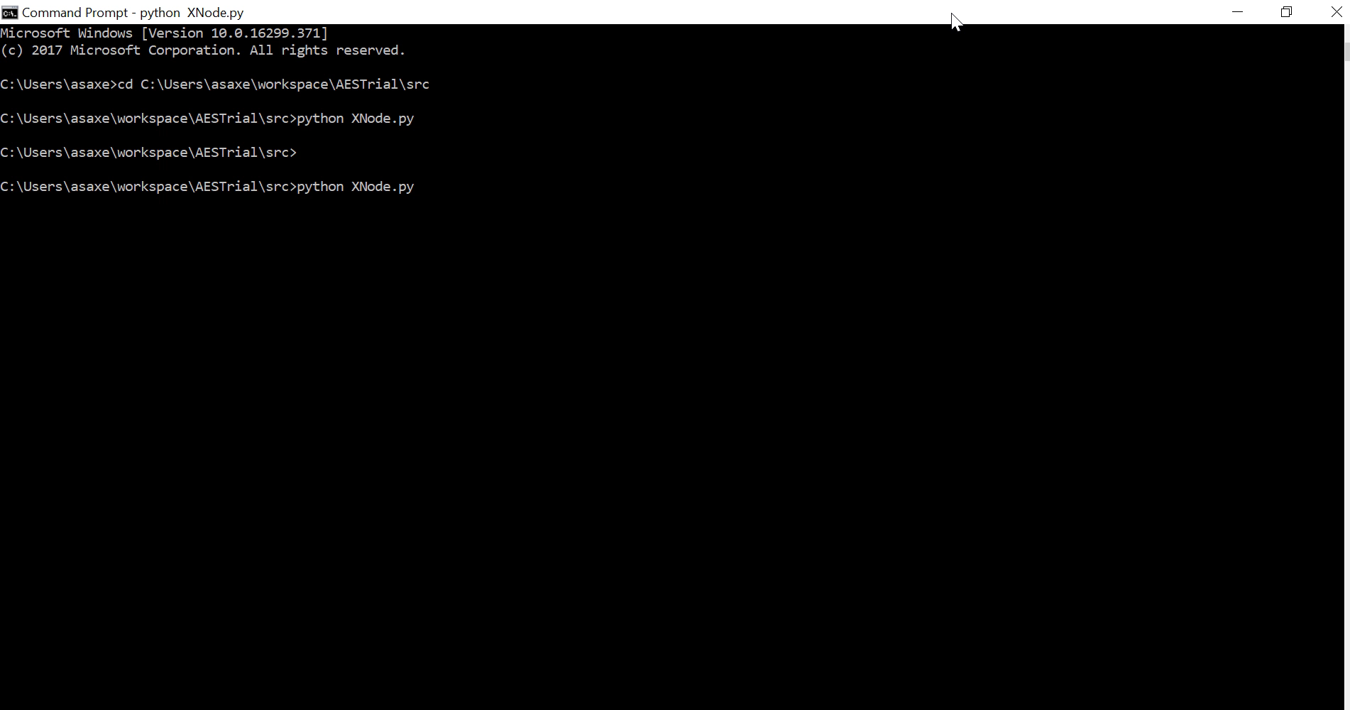
Case 1: Attacker listening to MQTT communication
X Node tries to all message communications of the stream.
client.subscribe("IAIproj/#")

Slide 22
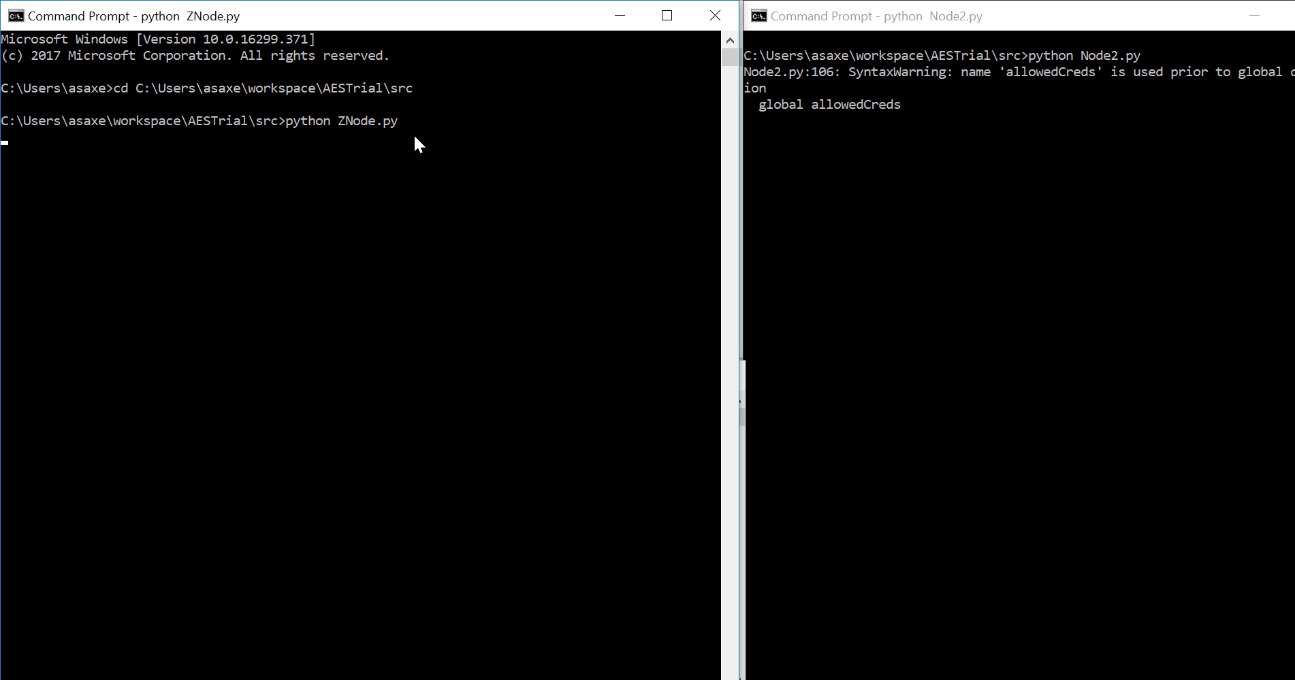
Case 2: Attacker tries to inject messages
Z Node tries to inject a message in Node 2 stream.
client.publish("IAIproj/2/inject", str('Inject fake message'))

Slide 23
Analysis

Slide 24
Analyzing overhead of encryption against unencrypted communication
Time Overhead
System time for unencrypted data: 1.19 seconds
System time taken for encrypted data: 0.84 seconds
Surprisingly the time taken for encrypted data communication in this case (with 3 nodes) was less than unencrypted data, but in a more advanced system time taken for encrypted communication is higher.

Slide 25
Analyzing overhead of encryption against unencrypted communication
Data overhead
Unencrypted Data exchanged 145 characters
Encrypted Data exchanged 163 characters
Overhead of 18 characters.
In case of AES encryption using PyCrypto API the length of plaintext needs to a multiple of 16 which requires blank spaces to be padded with the plaintext.

Slide 26

When/How my system can fail?
Brute Force Attack
An attacker who has access to all the communication channels can use Brute Force attack to decode the RSA encrypted AES private key. Once obtained the attacker can decrypt different parts of the conversation.
Man in the middle attack
In case where the communication pattern and public key is leaked, the attacker can decrypt parts of the conversation.
Implementing strict authentication and user access privileges can prevent injection attacks in both cases.

Slide 27
Conclusions
In case of Cloud Computing, secure data transmission is essential if the concept of IOT needs to be implemented in industrial arena.
Apart from encryption, authentication is required at each level to prevent masquerading and injection attacks.
Post authentication, user access privileges is another important factor which needs to be clearly defined. In case an active attacker does manage to disguise itself as a node in the system, the data and communication channels at risk are limited.

Slide 28
Thank you!!

